Slide 1
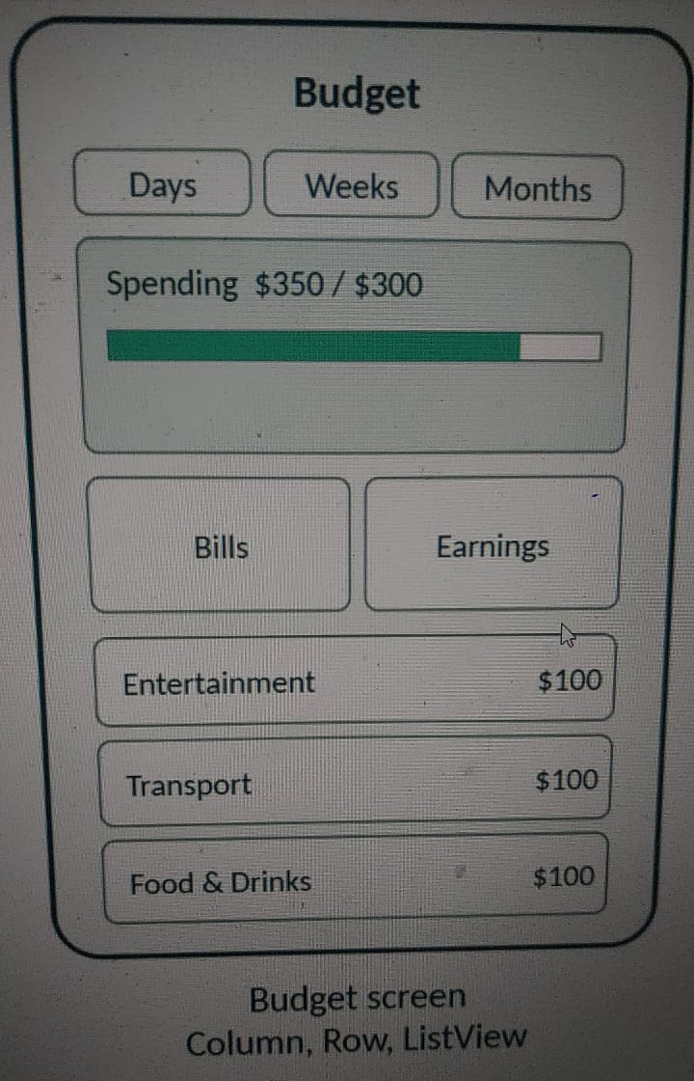
MOBILE APPLICATION
Penny Pilot
Track income, expenses and bills in one simple place
Students
Sami Housseiny
Hassan Nasser Dien

Slide 2
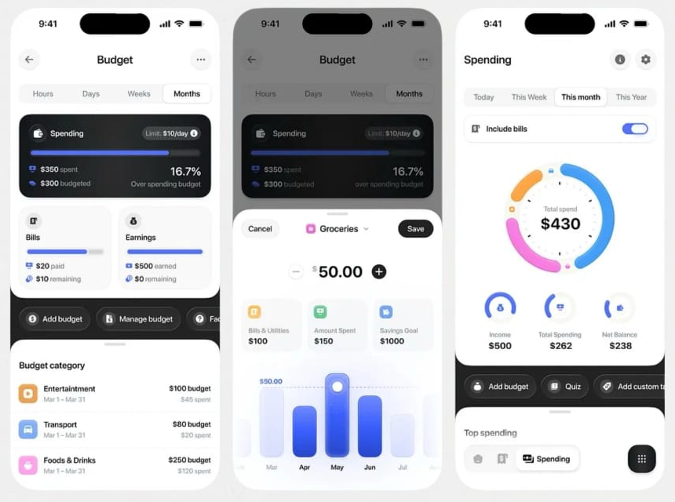
What is Penny Pilot
One app to understand where your money goes
1
Track income, expenses and bills in one place
2
Set a budget limit and follow category progress
3
Analyze spending with charts, then save your budget
Design inspiration: a Personal Budget app

Slide 3
Budget screen
WIDGETS USED
Column
Row
ListView
1
Period selector: Days, Weeks or Months
2
Spending card: $350 spent of a $300 limit, with a progress bar
3
Bills and Earnings summary cards side by side
4
List of category budgets: Entertainment, Transport, Food & Drinks

Slide 4
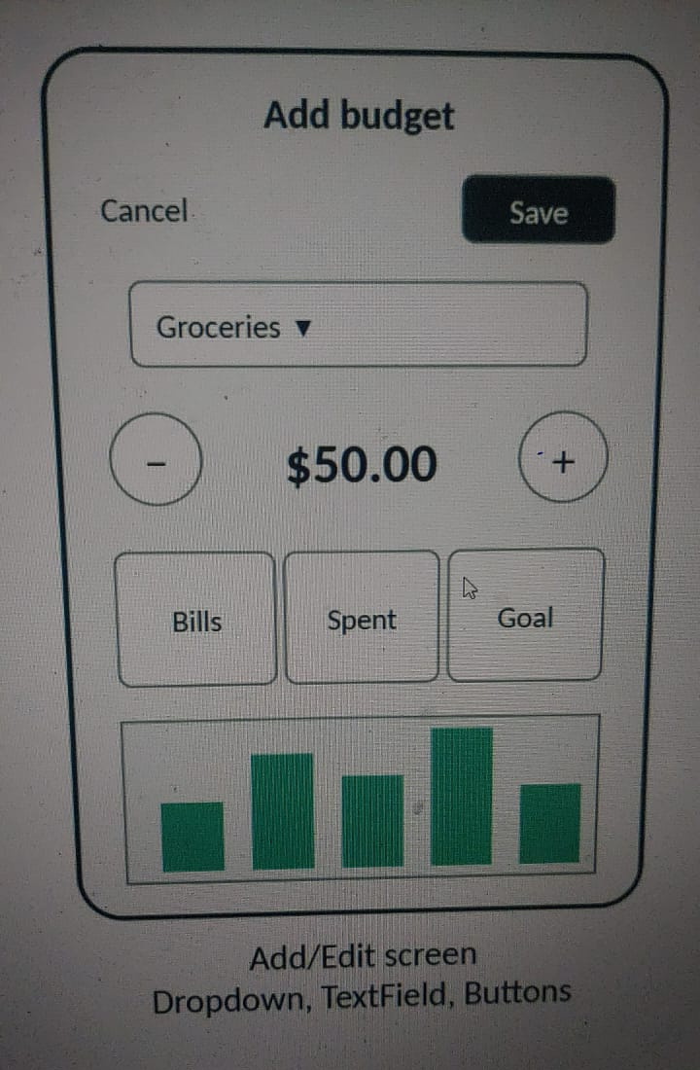
Add / Edit screen
WIDGETS USED
Dropdown
TextField
Buttons
1
Cancel and Save buttons at the top
2
Dropdown to choose the category, for example Groceries
3
Amount field with minus and plus buttons ($50.00)
4
Bills, Spent and Goal tiles with a bar chart of the budget

Slide 5
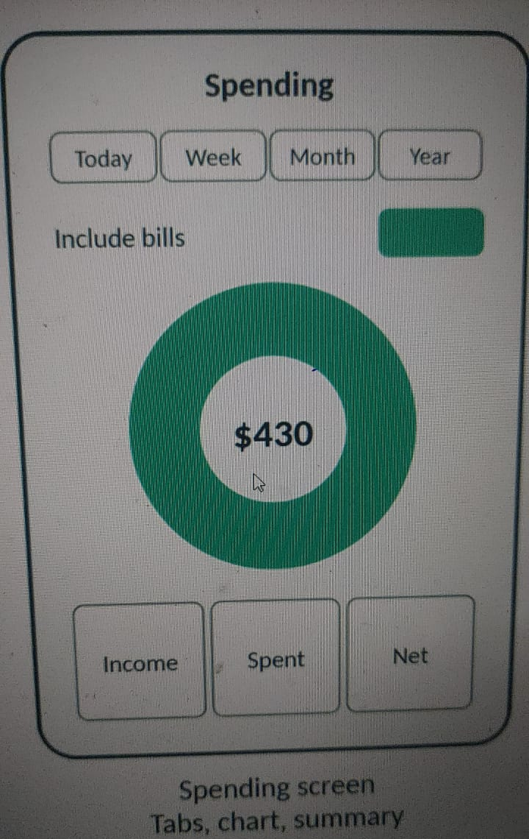
Spending screen
WIDGETS USED
Tabs
Chart
Summary
1
Tabs to switch between Today, Week, Month and Year
2
Include bills switch to change the total
3
Donut chart showing total spending ($430)
4
Income, Spent and Net summary tiles

Slide 6
Navigation map
Spending
Budget
Add / Edit
Tabs, chart, summary
Bottom navigation
Column, Row, ListView
Add budget / Save
Dropdown, TextField, Buttons
Budget is the home screen. From it the user adds or edits a budget, and moves to the Spending view to analyze the numbers.

Slide 7
Platforms and deployment
Mobile app
Web version
ANDROID STUDIO
GITHUB
Run the app on an Android emulator
Test the user interface while building
See how each screen behaves like a real phone
Web version hosted on GitHub
Shared with a public link (URL)
URL: add your GitHub link here

Slide 8
Roadmap
1
2
PHASE 1
PHASE 2
Proposal
App screens
Idea, GUI sketches and the navigation map
Build Budget, Add / Edit and Spending in Android Studio

Slide 9
Collaboration and workflow
1
2
3
4
Sketch the GUI
Draw the navigation map
Build in Android Studio
Push to GitHub
TEAM
Sami Housseiny
Hassan Nasser Dien
SH
HN

Slide 10
Thank you
Penny Pilot: your money, one simple place
Sami Housseiny | Hassan Nasser Dien
Questions?

